Slide 1
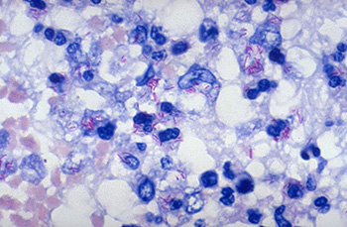
Mycobacterium tuberculosis

Slide 2
Introduction
M. tuberculosis causes tuberculosis.
It infects a third of the world’s population with 95% of those infected living in developing countries.
Factors contributing to the high prevalence of tuberculosis in developing countries and problems in its control include
: co-infection with HIV (single most important factor),
: emergence of multi-drug resistant tuberculosis,
: inadequate treatment
: continuing poverty
: malnutrition, overcrowding, armed conflict, and increasing
numbers of displaced persons.

Slide 3
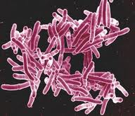
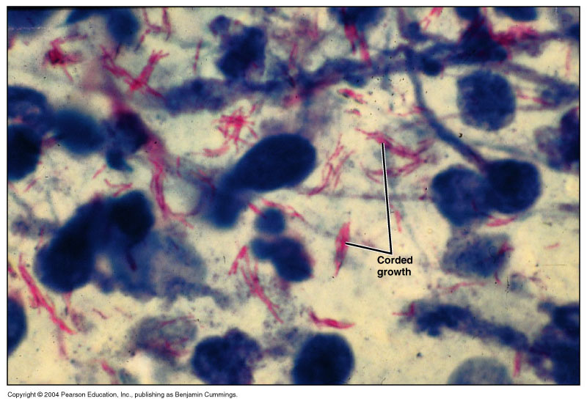
Morphology
TB are slender, acid-fast rods, 0.4 µm wide, and 3–4 µm long, non sporing, non capsulated and non motile.
Arranged singly, in pairs or in small clumps.
It is not stained easily by Gram method if stained takes colour of gram positive.
Hence widely stained with special agents ( Ziehl-Neelsen, Kinyoun, fluorescence)
Their cell envelope contain high amount (60-70%) of complex lipids: mycolic acid and chord factor.

Slide 4
characteristics
Culture done on Löwenstein-Jensen medium– have to grow for 6-8 weeks.
Their antigenic structure is complex– each type of mycobacterium has several proteins and polysaccharides.
Virulence factors: Cord factor and Mycolic acid(long chain fatty acid).

Slide 5
Pathogenesis
Modes of transmission:Air borne transmission i.e. It is transmitted by infected person by coughing and spitting which are inhaled by others.
The bacterium is facultative intracellular and may occur within cells or reticulo endothelial system RES, especially monocytes and macrophages
Primary tuberculosis infection: After infection, M tuberculosis bacilli multiplies in lungs and lymph glands.The bacilli is engulfed by machrophages where they multiply and forms initial lesion called Gohn’s complex usually in most people, the primary infection is self healing.Although not all the bacilli may be destroyed, some remains dormant in lymph nodes and may be reactive causing post primary disease.
Pulmonary tuberculosis: When primary infection doesnot heal completely or when there is continuous multiplication or reactivation of the organism in lungs, pulmonary tuberculosis occurs. Reactivation may occur due to immunosupression, poor health, malnutrition etc. In this case, there is destruction of lung tissue leading to caseation. Erosion in the walls of bronchi leads to discharge of liquified tissue and formation of cavity. Bacilli multiply in the cavity and can be found in the sputum.

Slide 6
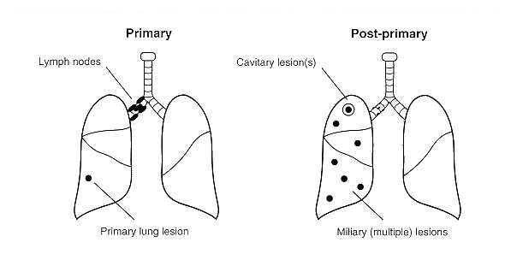
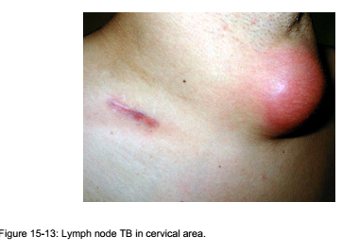
Miliary tuberculosis: It is widespread infection caused due to rupture of primary infection through the blood vessel. The liver, spleen and lymph gland may be enlarged and the meninges may also become infected.

Slide 7
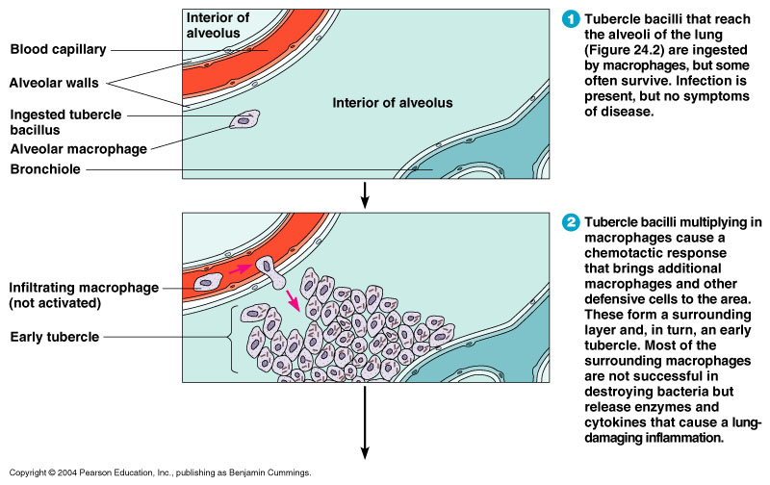
Progession

Slide 8
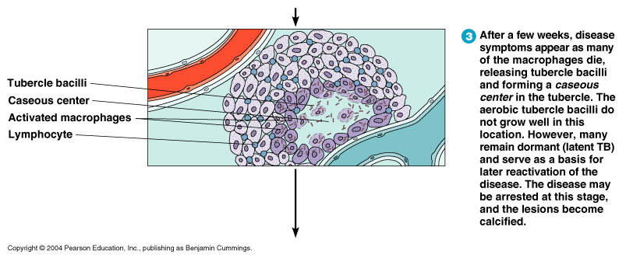
cntd

Slide 9
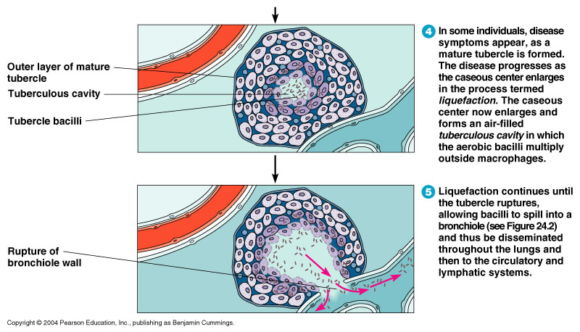
contd

Slide 10
Clinical manifestation
Pulmonary TB: chronic cough with production of mucoid and mucopurulent sputum which may be blood stained, loss of weight, tiredness, chest pain, fever and sweatening at night.
Complications: lung collaspe, pleural effusion, meningitis, renal and urogenital TB, infertility, Pelvic inflammatory Disease etc.
TB is common in HIV infected patients and is an AIDS defining condition

Slide 11


Slide 12
Lab diagnosis
SAMPLE: sputum, lymph node aspirates, urine sediments
Macroscopic view of sputum-purulant, mucopurulent and blood stain in the sputum.
Microscopy examination
AFB staining
Tuberculin skin test
Mantoux test:Purified protein derivative (PPD) tuberculin, it is a precipitate of species-nonspecific molecules obtained from filtrates of sterilized, concentrated cultures. 0.1 ml is injected intradermally (between the layers of dermis) and read 48 to 72 hours later. 5 mm, 10 mm, or 15 mm of induration is if observed, he/she has been exposed to TB.
Chest X-ray

Slide 13
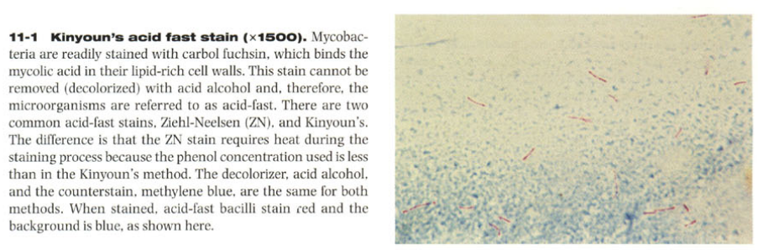
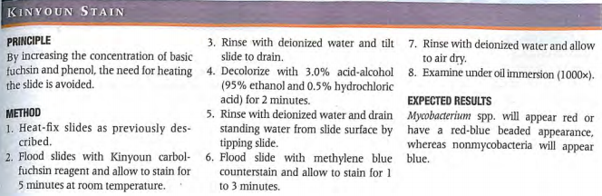

Slide 14
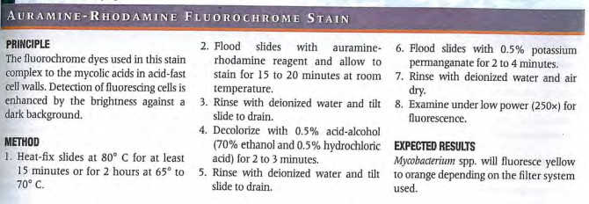
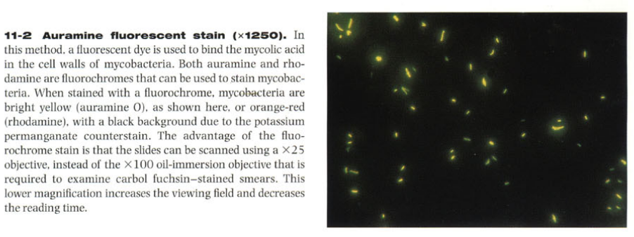

Slide 15
The GeneXpert MTB/RIF is a cartridge-based nucleic acid amplification test for simultaneous rapid tuberculosis diagnosis and rapid antibiotic sensitivity test. It is an automated diagnostic test that can identify Mycobacterium tuberculosis DNA and resistance to rifampicin.
The Xpert MTB/RIF detects DNA sequences specific for Mycobacterium tuberculosis and rifampicin resistance by polymerase chain reaction . It is based on the Cepheid GeneXpert system, a rapid, simple-to-use nucleic acid amplification tests (NAAT).

Slide 16
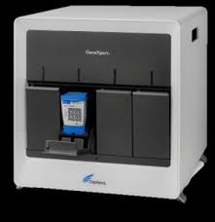

Slide 17
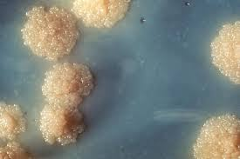
Culture:
Media:Lowenstein Jensen Media,Ogawa Media,Bactec Media (incubated at 37 degree cecius for 6-8 weeks).
Slow growers, may take upto at least 7 days of incubation to produce visible colonies
Colony characteristics:Dry, rough, raised 3-4 mm in diameter, irregular, first creamy white latter it becomes yellowish or buff colour
Biochemical: M. tuberculosis shows positive in niacin, arylsulphatase, nitrate reduction tests.

Slide 18
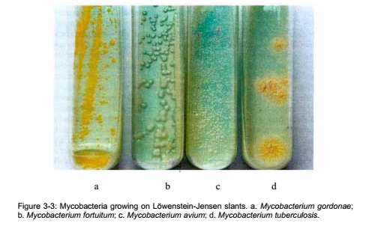

Slide 19
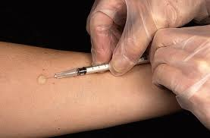
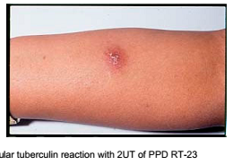

Slide 20
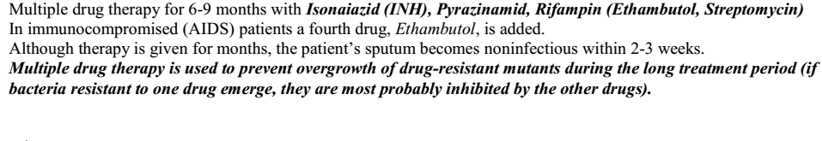
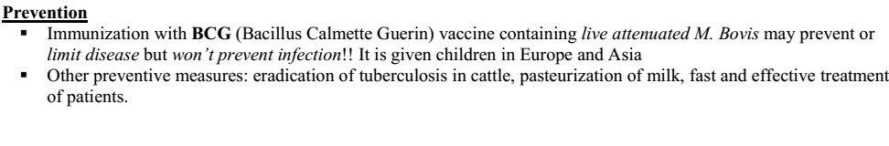
Treatement

Slide 21
DOTS Plus strategy - includes monthly monitoring of patients for presence of resistant strains and changing drug regimen as resistance status changes

Slide 22
